Slide 1
CONTENT
1. Introduction
2. Command line
4. Shell
5. cmd.exe
6. Importance of windows shell

Slide 2
Windows shell
THE WINDOWS SHELL IS THE COMMAND LINE INTERFACE FOR THE MICROSOFT WINDOWS OPERATING SYSTEM. ITS READILY IDENTIFIABLE ELEMENTS CONSISTS OF THE DESKTOP, THE TASKBAR, THE START MENU, THE TASK SWITCHER AND THE AUTOPLAY FEATURE.

Slide 3
Command line of windows
cmd command | Description
Basics:
cls | clear console screen
cmd | start command prompt
date | show/set date
dir | list directory content
diskpart | volume management
exit | exits the command prompt or a batch file
help | show command list

Slide 4
cmd command | Description
Basics:
hostname | display computer name
ipconfig | display ip network settings
cmd | start command prompt
logoff | logoff Computer
mkdir | make new directory
os | check os with bit
powershell | start windows powershell
restart | restart the computer
shell | display about shell
tasklist | display running process
vol | show HDDs serial number(s)
winver | show about windows version

Slide 5
C shell
The C shell is a command processor typically run in a text window, allowing the user to type commands. The C shell can also read commands from a file, called a script. Like all Unix shells, it supports filename wildcarding, piping, here documents, commandsubstitution, variables and control structures for condition-testing and iteration. What differentiated the C shell from others, especially in the 1980s, were its interactive features and overall style. Its new features made it easier and faster to use. The overall style of the language looked more like C and was seen as more readable.

Slide 6
cmd.exe
cmd.exe is the default command-line interpreter for OS/2 eComStation, ArcaOS, Microsoft Windows (Windows NT family and Windows CE family), and the ReactOS operating systems. The name refers to its executable filename. It is also commonly referred to as cmd or the Command Prompt, referring to the default window title on Windows. The implementations differ on the various systems but the behavior and basic set of commands is generally consistent. cmd.exe is the counterpart of COMMAND.COM in DOS and Windows 9x systems, and analogous to the Unix shells used on Unix-like systems. The initial version of cmd.exe for Windows NT was developed by Therese Stowell. Windows CE 2.11 was the first embedded Windows release to support a console and a Windows CE version of cmd.exe

Slide 7
Importance of windows shell
Windows Shell provides desktop environment, start menu, and task bar, as well as a graphical user interface for accessing the file management functions of the operating system. Older versions also include Program Manager, which was the shell for the 3.
Is Windows Shell experience Host necessary?
Actually, it is not recommended to disable Windows Shell Experience Host. Disabling Windows Shell Experience Host will prevent you from getting the necessary visuals in Windows 10. Besides, even if you end the process, Windows 10 will restart it automatically in a while.

Slide 8
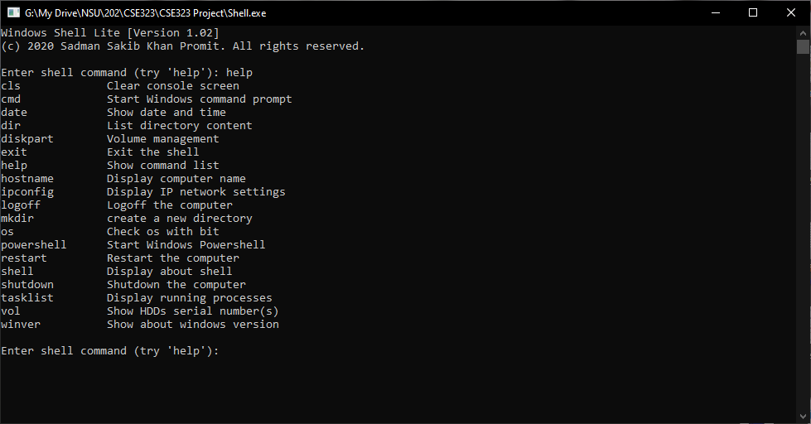
The Interface

